Slide 1
COVID-19 Update
June 17, 2021

Slide 2
Outline
1. MOH Update - Dr. Wadieh Yacoub, Dr. Chris Sarin, & Simon Sihota
2. COVID-19 Vaccine Update – Dr. Chris Sarin
3. COVID-19 and Wastewater – Dr. Xiaoli Lilly Pang
4. Questions

Slide 3
MOH Update
DR. WADIEH Yacoub, senior medical officer of health
Dr. Chris Sarin, Deputy medical officer of health
Simon Sihota, regional MANGER, environmental public health SERVICES

Slide 4
Reminder - Privacy
All information related to an individual who is or was infected with a communicable disease shall be treated as private and confidential
No information shall be published, released or disclosed in any manner that would be detrimental to the personal interest, reputation or privacy of that individual.
Notes:
Keep?

Slide 5
Current Situation – Canada (as of June 16, 2021)
Total number of active cases in Canada:
14,148
Public Health Agency of Canada https://health-infobase.canada.ca/covid-19/dashboard/?stat=rate&measure=total_last14&map=hr&f=true#a2

Slide 6
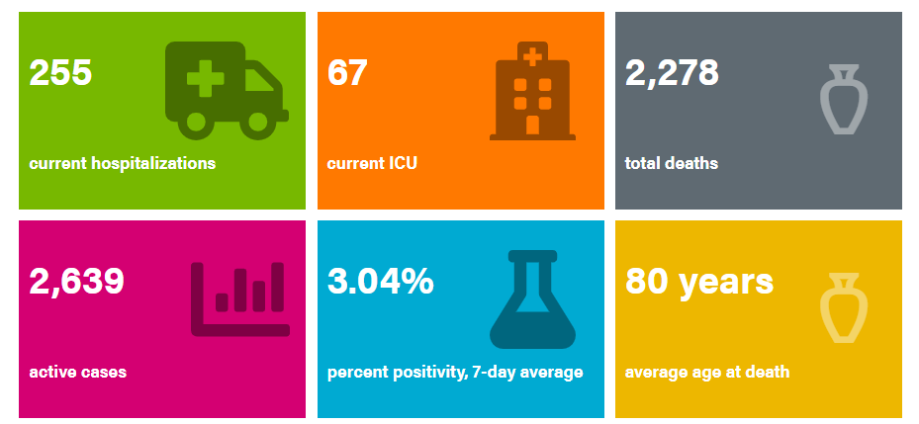
Current Situation - Alberta
Overview of COVID-19 in Alberta (as of June 15, 2021):
Interactive Alberta data can be found at: https://covid19stats.alberta.ca/

Slide 7
Overview of COVID-19 cases in First Nations communities on reserve in Alberta Source: FNIHB COVID-19 ER System via Synergy in Action (June 16, 2021)
8,775 Total COVID-19 cases |  | 4,274 (48.7%) Males |  | 46 Impacted communities ever |  | 483 Hospitalized ever |  | 111 ICU ever
27 Communities with active cases |  | 21 Currently in Hospital |  | 8,415 Recovered |  | 274 Active |  | 86 Deaths
Notes:
As of June 15th:
Confirmed and probable cases: 8,775
Total active cases: 274
Recovered: 8,415
Communities with active cases: 27

Slide 8
Age distribution of on-reserve COVID-19 cases in Alberta Source: FNIHB COVID-19 ER System via Synergy in Action (June 16, 2021)

Slide 9
COVID-19 cases by week of onset* by Treaty Area Source: FNIHB COVID-19 ER System via Synergy in Action (June 16, 2021)
*Onset date is the earliest of the “date of onset of symptoms” and “specimen collection date”
^Data may be incomplete due to late receipt of lab reports

Slide 10
Severe Outcomes Sources: FNIHB COVID-19 ER System via Synergy in Action (June 16, 2021) & https://www.alberta.ca/stats/covid-19-alberta-statistics.htm (June 14, 2021)
 |  | Total Case Hospitalization Rate |  | Total Case ICU Rate |  | Case Fatality Rate
Treaty 6 |  | 4.6 per 100 Cases |  | 1.0 per 100 Cases |  | 0.8 per 100 Cases
Treaty 7 |  | 7.7 per 100 Cases |  | 1.8 per 100 Cases |  | 1.4 per 100 Cases
Treaty 8 |  | 4.8 per 100 Cases |  | 1.2 per 100 Cases |  | 0.9 per 100 Cases
First Nations Communities (on reserves) |  | 5.5 per 100 Cases |  | 1.3 per 100 Cases |  | 1.0 per 100 Cases
Alberta (includes First Nations communities) |  | 4.1 per 100 Cases |  | 0.8 per 100 Cases |  | 1.0 per 100 Cases

Slide 11
Severe Outcomes –Average Age Sources: FNIHB COVID-19 ER System via Synergy in Action (June 16, 2021) & https://www.alberta.ca/stats/covid-19-alberta-statistics.htm (June 14, 2021)
 |  | Average age of cases hospitalized |  | Average age of ICU cases |  | Average age of deceased cases |  | Average age of non-hospitalized cases
Treaty 6 |  | 52 years (range:14-88) |  | 54 years (range:17-88) |  | 66 years (range:23-88) |  | 29 years (range:0-94)
Treaty 7 |  | 55 years (range:16-86) |  | 57 years (range:21-78) |  | 64 years (range:20-86) |  | 30 years (range:0-87)
Treaty 8 |  | 56 years (range:1-93) |  | 59 years (range:20-82) |  | 72 years (range:48-93) |  | 28 years (range:0-87)
First Nations Communities (on reserves) |  | 54 years (range:1-93) |  | 57 years (range:17-88) |  | 67 years (range:20-93) |  | 29 years (range:0-94)
Alberta (includes First Nations communities) |  | 60 years (range:0-104) |  | 57 years (range:0-90) |  | 80 years (range:20-107) |  | 35 years (range:0-108)
Notes:
-

Slide 12
Test Volume Sources: Community Reports to FNIHB-AB (June 16, 2021)
^late reporting from some communities
 |  | Test volume |  | Percent positive test
First Nations (on reserve)* |  | 128,506 |  | 6.8%
All Albertans |  | 4,611,956 |  | 5.0%
*some communities are not reporting testing data to FNIHB-AB, so percent positive test may be overestimated

Slide 13
Alberta COVID-19 Testing Criteria
Testing is available for:
any person exhibiting any symptoms of COVID-19
all close contacts of confirmed COVID-19 cases
all workers and/or residents at specific outbreak sites
Asymptomatic testing has been paused for people who have no known exposure to COVID-19.
FNIHB MOHs will provide guidance to prioritize testing in First Nation communities with cases.
Notes:
https://www.alberta.ca/covid-19-testing-in-alberta.aspx

Slide 14
COVID-19 Variant of Concern Testing
Due to the large number of positive COVID-19 cases, the provincial lab only screened a sample of positive cases for variants of concern between May 1, 2021 - May 31, 2021.
As of June 1, 2021, variant of concern testing resumed for all COVID-19 positive samples.

Slide 15
Number of Reported COVID-19 Variant of Concern Cases, by Location as of June 15, 2021
Location | B.1.1.7 (Alpha) First identified in the UK | B.1.351 (Beta) First identified in South Africa | B.1.617.2 (Delta) First identified in India | P.1 (Gamma) First identified in Brazil | Total Number of Variant Cases Reported
AB First Nations On-Reserve | 914 | 0 | 2 | 26 | 942
Alberta (includes cases on-reserve ) | 44,959 | 156 | 356 | 2,704 | 48,175
Canada | 215,166 | 1,915 | 1,766 | 15,290 | 234,137
Notes:
The B.1.1.7 (UK variant) continues to account for the majority of VOC cases to date.
Calgary Zone has the majority of B.1.617.2 (Delta Variant) cases - 307 out of 356.
Edmonton Zone has the most P.1 (Gamma Variant) cases - 1,008 out of 2,704.
Delta variant is specific to B.1.617.2. B.1.617.1 is considered by WHO to be a Variant of Interest and has the label of Kappa.
Sources:
AH - https://www.alberta.ca/stats/covid-19-alberta-statistics.htm#variants-of-concern
PHAC - https://health-infobase.canada.ca/covid-19/epidemiological-summary-covid-19-cases.html#VOC
ISC - FNIHB
WHO - https://www.who.int/en/activities/tracking-SARS-CoV-2-variants/

Slide 16
Current Situation: Stage 2 Re-Opening
Started June 10th:
Two weeks after 60% of Albertans 12+ received at least one dose of vaccine and hospitalizations were below 500 and declining.
Public Health Measures in Effect:
Work from home order is lifted but still recommended
Physical distancing and masking requirements remain in effect
Outdoor social gatherings – up to 20 people with distancing (indoor social gatherings still not permitted)
Funeral services – up to 20 people, indoors and outdoors (receptions permitted outdoors only)
Wedding ceremonies – up to 20 people, indoors and outdoors (receptions permitted outdoors only)
Restaurants – 6 people per table max, indoors or outdoors
Places of worship – 1/3 of fire code occupancy

Slide 17
Stage 2: Public Health Measures in Effect (cont’d)
Gyms and fitness studios – open for solo and drop-in activities and indoor fitness classes with 3 metre distancing
Retail – 1/3 of fire code occupancy (must maintain ability to distance)
Youth activities (day camps, overnight camps, play centres) – resume with restrictions
Youth and adult sports – resume with no restrictions, indoors and outdoors
Outdoor public gatherings (concerts/festivals) – up to 150 people
Outdoor fixed seating facilities (grandstands) – 1/3 seated capacity
Personal and wellness services – resume walk-in service
Post-secondary – resume in-person learning
Indoor recreation, entertainment and other settings (rec centres, arenas, casinos, cinemas, theatres, museums, galleries, libraries, etc.) – open at 1/3 of fire code occupancy
For further information, refer to: https://www.alberta.ca/enhanced-public-health-measures.aspx

Slide 18
Next Step: Stage 3 Re-Opening
Expected to occur two weeks after 70% of Albertans 12+ (born in 2009 or earlier) have received at least one dose of COVID-19 vaccine
Will likely begin in early July
During this stage, all restrictions will be lifted, including the ban on indoor social gatherings.
Isolation requirements for confirmed cases of COVID-19 and some protective measures in continuing care settings will remain in effect.

Slide 19
COVID-19 Vaccine Update
Dr. Chris Sarin, Deputy medical officer of health

Slide 20
Cumulative Number of COVID-19 Vaccine Doses Administered in Canada by Jurisdiction as of June 16, 2021
Source: https://health-infobase.canada.ca/covid-19/vaccine-administration/

Slide 21
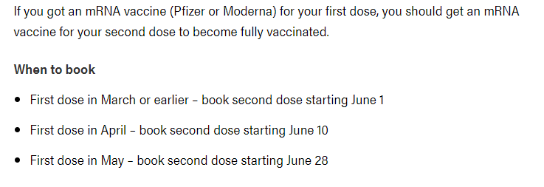
Alberta Vaccine Program
Everyone born in 2009 or before (turning 12+) can get their first dose now.
Second doses are being offered in stages.

Slide 22
COVID-19 Vaccine Data – Alberta
As of June 15th in Alberta:
Up to date information can be found at https://www.alberta.ca/covid19-vaccine.aspx

Slide 23
COVID Immunization Activity – On Reserve in Alberta Source: Okaki Slice Analytics (June 16, 2021)
Doses administered 52,841 |  | Number of people who have received at least one dose 31,606 |  | Number of people who are fully immunized (2 doses) 21,235 |  | Number of Nations (bands) with Immunizations 46

Slide 24
COVID Immunization Activity – On Reserve in Alberta Source: Okaki Slice Analytics (June 16, 2021)

Slide 25
COVID Immunization Activity – On Reserve in Alberta Source: Okaki Slice Analytics (June 16, 2021)

Slide 26
COVID Immunization Activity – On Reserve in Alberta Source: Okaki Slice Analytics (June 16, 2021)

Slide 27
Reported side effects following COVID-19 vaccination in Canada and Alberta
Canada
as of JUNE 4, 2021
Alberta
as of june 15, 2021
3,533,434 Doses administered
564 Adverse Events reported
ALBERTA FIRST NATIONS ON RESERVE
AS OF JUNE 16, 2021
52,841 Doses Administered
28 Adverse Events reported

Slide 28
COVID-19 Vaccine Effectiveness in Alberta by Vaccine Manufacturer
Vaccine | Effectiveness Against Symptomatic Illness: 14 Days After First Dose (95% CI) | Effectiveness Against Symptomatic Illness: 14 Days After Second Dose (95% CI)
Moderna | 82% (80 to 84%) | 93% (90 to 96%)
Pfizer | 73% (72 to 74%) | 90% (88 to 91%)
Source: https://www.alberta.ca/stats/covid-19-alberta-statistics.htm#vaccine-outcomes
Notes:
Vaccine effectiveness for hospitalization and death could have different estimates.

Slide 29
COVID-19 Vaccine Effectiveness Against Variants of Concern in Alberta
Variant of Concern | Effectiveness Against Symptomatic Illness: 14 Days After First Dose (95% CI) | Effectiveness Against Symptomatic Illness: 14 Days After Second Dose (95% CI)
B.1.1.7 (Alpha) First identified in the UK | 73% (72 -75%) | 91% (89 – 92%)
P1 (Gamma) First identified in Brazil | 75% (68 – 81%) | 89% (77 – 95%)
Source: https://www.alberta.ca/stats/covid-19-alberta-statistics.htm#vaccine-outcomes
Notes:
At this time, vaccine effectiveness estimates for AstraZeneca and emerging variants in Alberta are not available as sample sizes are limited. This makes estimates unstable and difficult to interpret.

Slide 30
COVID-19 Vaccine Effectiveness Against Delta (B.1.617.2) Variant – UK Study
Vaccine | Effectiveness Against Symptomatic Illness: 21 Days After First Dose | Effectiveness Against Symptomatic Ilness: 14 Days After Second Dose
Pfizer-BioNTech (mRNA) | 33% | 88%
AstraZeneca (viral vector) | 33% | 60%
Source: Public Health England https://www.gov.uk/government/news/vaccines-highly-effective-against-b-1-617-2-variant-after-2-doses
Notes:
This study provides reassurance that 2 doses of either vaccine offer high levels of protection against symptomatic disease from the B.1.617.2 variant.

Slide 31
Effectiveness of COVID-19 vaccines against hospital admissions with the Alpha (B.1.1.7) Delta (B.1617.2) Variants – UK Study
Vaccine | Effectiveness After First Dose Alpha (B.1.1.7) | Effectiveness After Second Dose Alpha (B.1.1.7) | Effectiveness After First Dose Delta (B.1.617.2) | Effectiveness After Second Dose Delta (B.1.617.2)
Pfizer-BioNTech (mRNA) | 83% | 95% | 94% | 96%
AstraZeneca | 76% | 86% | 71% | 92%
Source: Stowe J et al. Effectiveness of COVID-19 vaccines against hospital admission with the Delta (B.1617.2)
Notes:
This study measured the vaccine effectiveness of the Pfizer and AZ vaccines against hospitalization due to the Alpha and Delta variants in England.
The Pfizer and AstraZeneca vaccines are both very effective at preventing hospitalization from the Alpha (B.1.1.7) and Delta (B.1.617.2) variants, including with only one dose, particularly for the Pfizer vaccine.

Slide 32
For COVID-19 resources and links to credible sources of information
Go to the alberta one health covid-19 update page
https://www.onehealth.ca/ab/ABCovid-19

Slide 33
Farewell Comments from Dr. Yacoub….

Slide 35
Acknowledgments
Dr. Xiaoli Lilly Pang, Professor of Laboratory Medicine and Pathology – U of A
Dr. Wadieh Yacoub, Senior Medical Officer of Health - FNIHB
Dr. Chris Sarin, Deputy Medical Officer of Health - FNIHB
Simon Sihota, Regional Manager, EPHS – FNIHB
Ibrahim Agyemang, Senior Epidemiologist – FNIHB
TSAG Telehealth Team (Michelle Hoeber, Brooke Hames and team)
FNIHB Technical Team

Slide 36
Questions?
VCHELP@FNTN.CA

